Slide 1


Welcome to the
US 50/301 Pedestrian Overpass Feasibility Study
Public Meeting

Slide 2
Project Purpose
Queen Anne’s County, in partnership with Baltimore Metropolitan Council, is conducting a feasibility study to identify a safe and accessible pedestrian/bicycle crossing of the US 50/301 Corridor.
The purpose of this Public Meeting is to:
Provide background on the Study
Discuss options considered
Request public feedback on preferred options

Slide 3
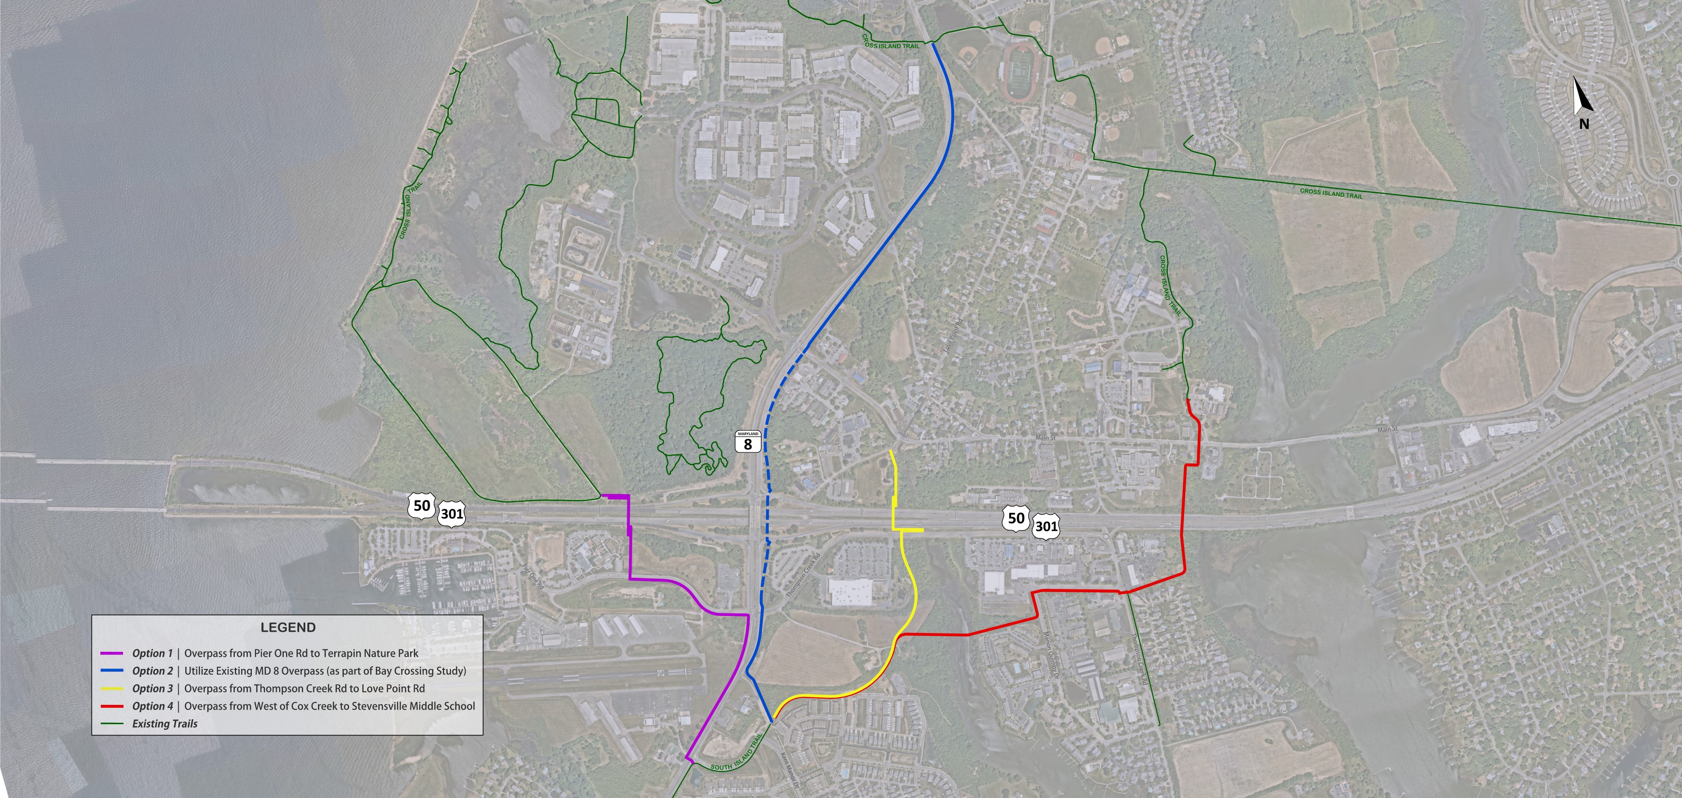
Options Considered

Slide 4
Options Considered
OPTION 1 | Overpass from Pier One Rd to Terrapin Nature Park
Direct connection from South Island Trail to Terrapin Nature Park
Connects to Cross Island Trail via existing trail network within Terrapin Nature Park
Provides public access to the Chesapeake Bay
Connects to the Chesapeake Bay Beach Club, residential areas, and Chesapeake Bay Business Park
Closest to Chesapeake Bay Bridge
OPTION 2 | Existing MD 8 Overpass (as part of Bay Crossing Study)
Connection between South Island and Cross Island trails along MD 8
Could only advance if MD 8 overpass is reconstructed as part of future MDTA Bay Bridge project
Existing overpass cannot be retrofitted to accommodate trail
Crosses US 50/301 interchange ramps
OPTION 2 is not being advanced.

Slide 5
Options Considered
OPTION 3 | Overpass from Thompson Creek Rd to Love Point Rd
Connection between South Island Trail and Stevensville; no direct connection to Cross Island Trail
Significant impacts to existing utility infrastructure
OPTION 3 is not being advanced.
OPTION 4 | Overpass from West of Cox Creek to Stevensville Middle School
Connection between South Island and Cross Island trails through Stevensville
Connection to existing Thompson Creek Rd shared use path
Connection to library and schools
Crosses Thompson Creek

Slide 6
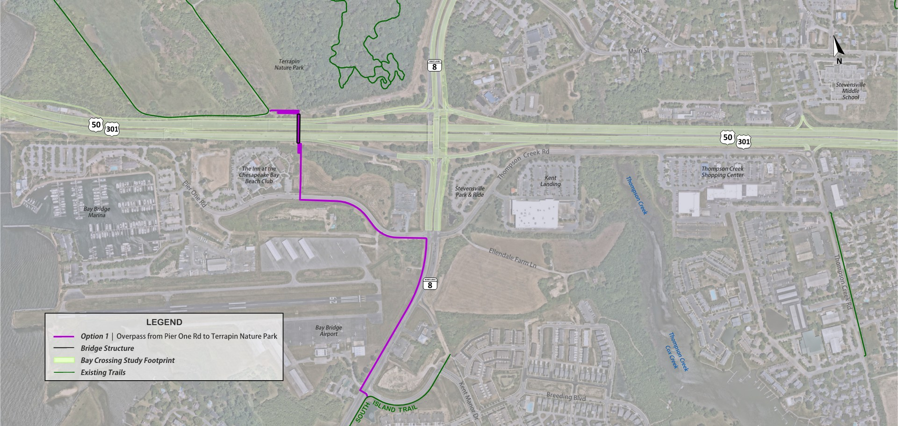
OPTION 1 | Overpass from Pier One Rd to Terrapin Nature Park

Slide 7
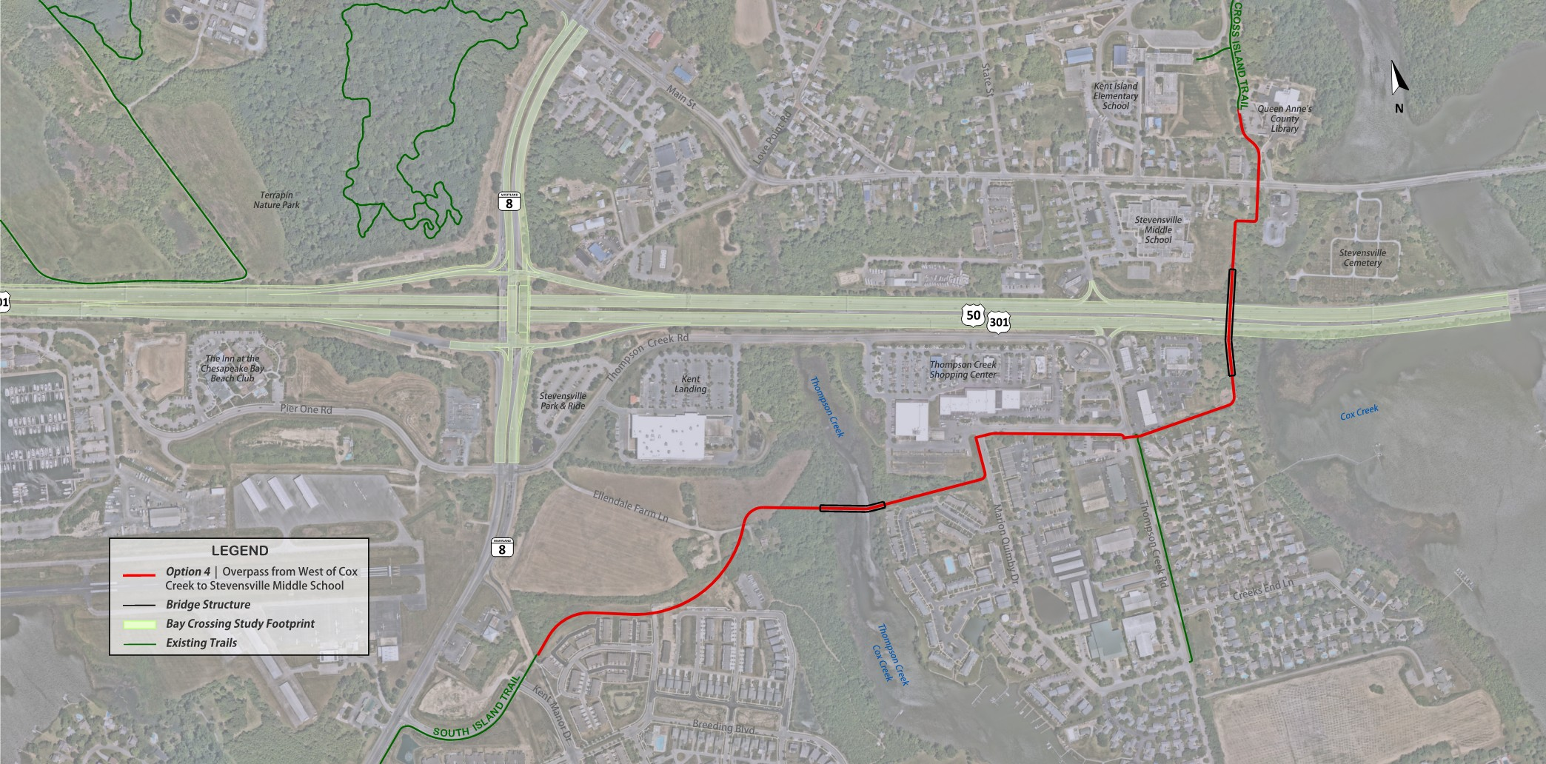
OPTION 4 | Overpass from West of Cox Creek to Stevensville Middle School

Slide 8
Options 1 & 4 | Fast Facts
OPTION 1
OPTION 4
CONNECTIVITY
CONNECTIVITY
Connection between South Island and Cross Island Trails, via Terrapin Nature Park
Public access to the Chesapeake Bay
Connections to Chesapeake Bay Beach Club, residential areas, and Chesapeake Bay Business Park
Crosswalks at Pier One Rd and crosswalk or overpass at Romancoke Road (MD 8) near Kent Manor Drive
Connection between South Island and Cross Island trails through Stevensville
Direct connection to Thompson Creek Road shared use path
Connections to Queen Anne’s County Library, Stevensville Middle School, Kent Island Elementary School, and Thompson Creek Shopping Center
Crosswalks at Main Street (MD 18), Thompson Creek Road, and Marion Quimby Drive

Slide 9
Options 1 & 4 | Fast Facts
OPTION 1
OPTION 4
OVERPASS CONSIDERATIONS
OVERPASS CONSIDERATIONS
Overpass Bridge Length: 260’
Ramp approaches with retaining wall
Overpass Bridge Length: 220’
Ramp approaches with combination of bridge and retaining wall
TRAIL CONSIDERATIONS
TRAIL CONSIDERATIONS
Length of New Trail: 4,450’ | 0.8 miles
Length of Additional Improvements: 6,900’ | 1.3 miles (upgrade of existing trail in Terrapin Nature Park)
Total Trail Length between Cross Island and
South Island Trails: 11,350’ | 2.2 miles
Length of New Trail: 6,500’ | 1.2 miles
Total Trail Length between Cross Island and
South Island Trails: 6,500’ | 1.2 miles
Bridge structure required to cross Thompson Creek

Slide 10
Options 1 & 4 | Fast Facts
OPTION 1
OPTION 4
POTENTIAL CHALLENGES
POTENTIAL CHALLENGES
Would need to accommodate Bay Crossing Study selected alternative
Proximity to Bay Bridge along with MDTA highway and bridge operations may impact overpass design
Upgrades to existing Terrapin Nature Park trail would be required
Trail crossing over Thompson Creek and through other sensitive environmental features
Securing private property easements/right-of-way

Slide 11




Next Steps and Feedback
Next Steps
Accept public comments
Present to County Commissioners
Seek additional feedback/concurrence from SHA/MDTA
Learn more tonight by reviewing the displays and talking to project staff!
Share your thoughts by:
Filling out a paper comment form tonight
Emailing your comments to publiccomment@qac.org
Mailing your completed comment form by Nov. 6
Sharing your thoughts on a sticky note on the Options 1 and 4 Maps

